Slide 1
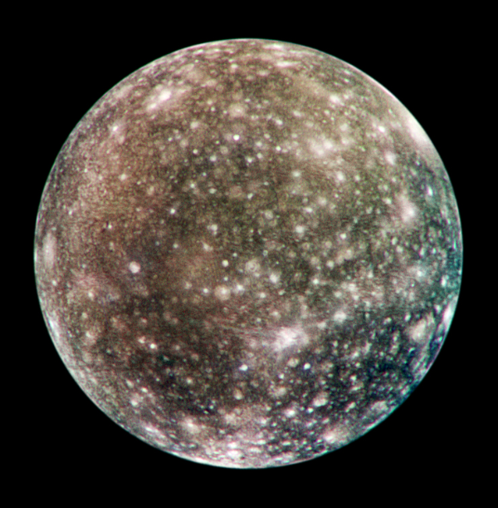



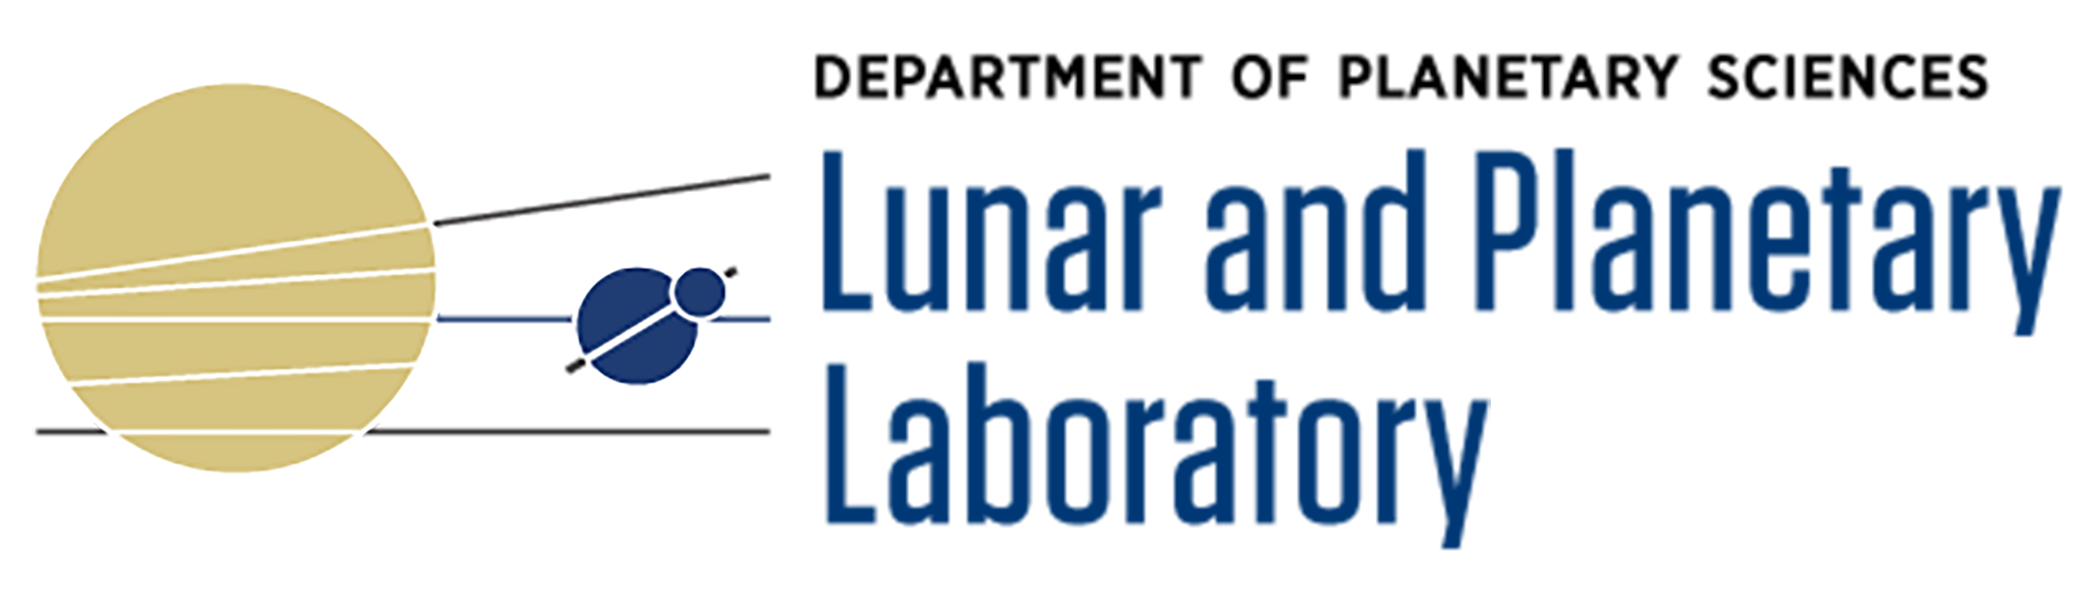
Multi-Ring Impact Basins on Callisto
Presenter: Shea DeFour-Remy
Mentor: Veronica Bray
Institution: University of Arizona
AZSGC Symposium 2022
Time: 04/23/22
Space: Tucson, AZ
Source: https://photojournal.jpl.nasa.gov/target/callisto

Slide 2
Callisto as a Baseline
Callisto is not boring!
Multi-ring impact basins
Importance of “inactive” worlds
Estimate planetary body’s crustal thickness and heat flow
Establish relative timescale evolution of heat flow

Slide 3
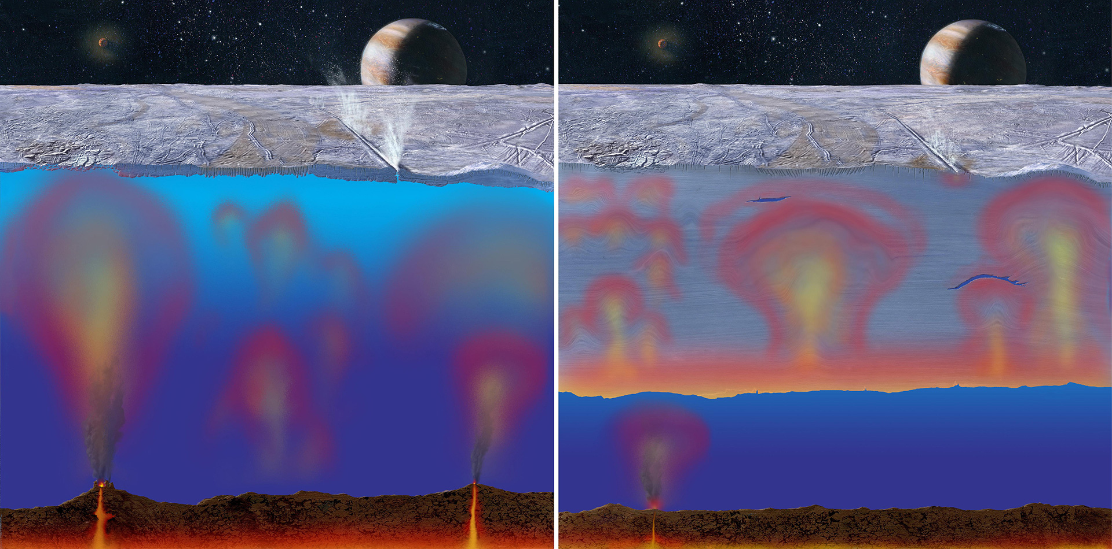
Crustal Thickness and Heat Flow
Source: NASA/JPL/Michael Carroll; https://europa.nasa.gov/resources/36/thick-or-thin-ice-shell-on-europa/
Notes:
Heat flow is how well the (planetary) body transfers energy through its subsurface. Low heat flow would yield a thicker crust as material would be in motion for less time whilst high heat flow would yield a thinner crust, due to an opposite situation where they cannot settle down. By estimating heat flow of such an inactive body, we can determine a baseline for how more active icy bodies' heat flow should evolve over time.

Slide 4
Acquisition of Basin Centers
ArcMap as primary measurement tool
Challenges of Callisto
(deserves its own presentation)
The importance of reprojection
Average center of palimpsest
Arc-orthogonal method
Notes:
- Image resolution, albedo differences on surface not allowing for photoclinometry
- Want to take angled image and stretch it out flat in front of us for primary transects

Slide 5
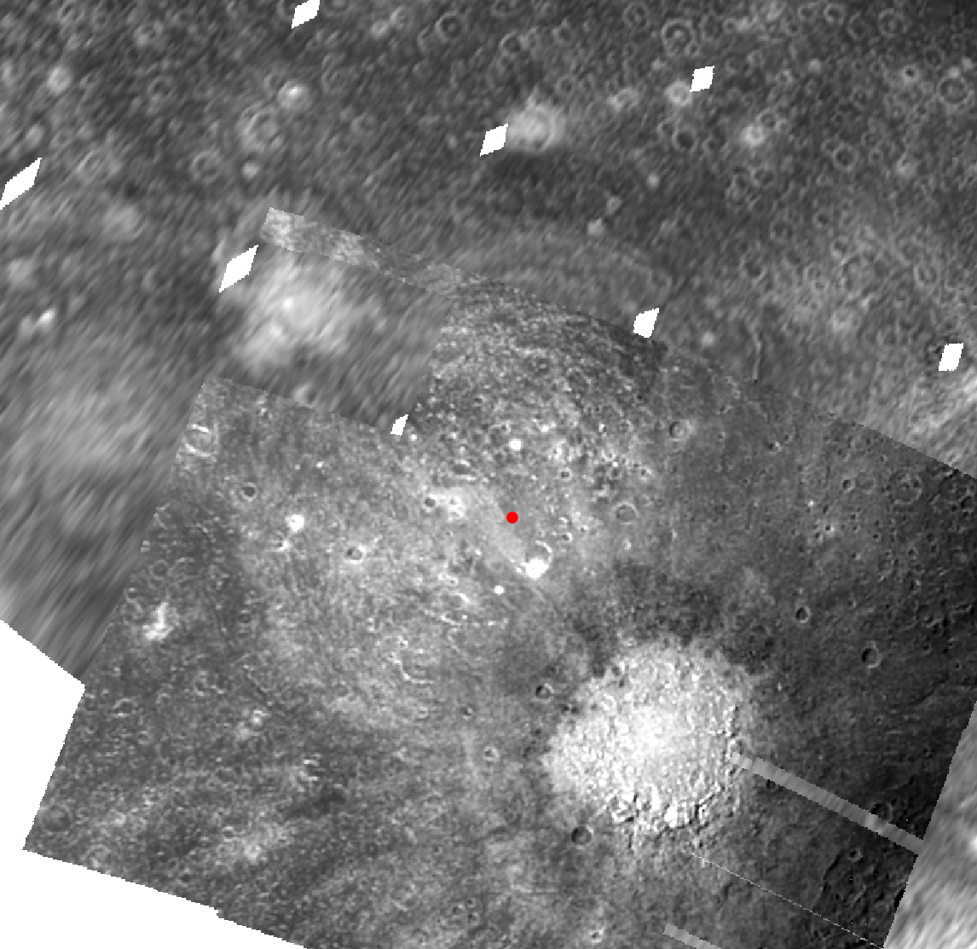
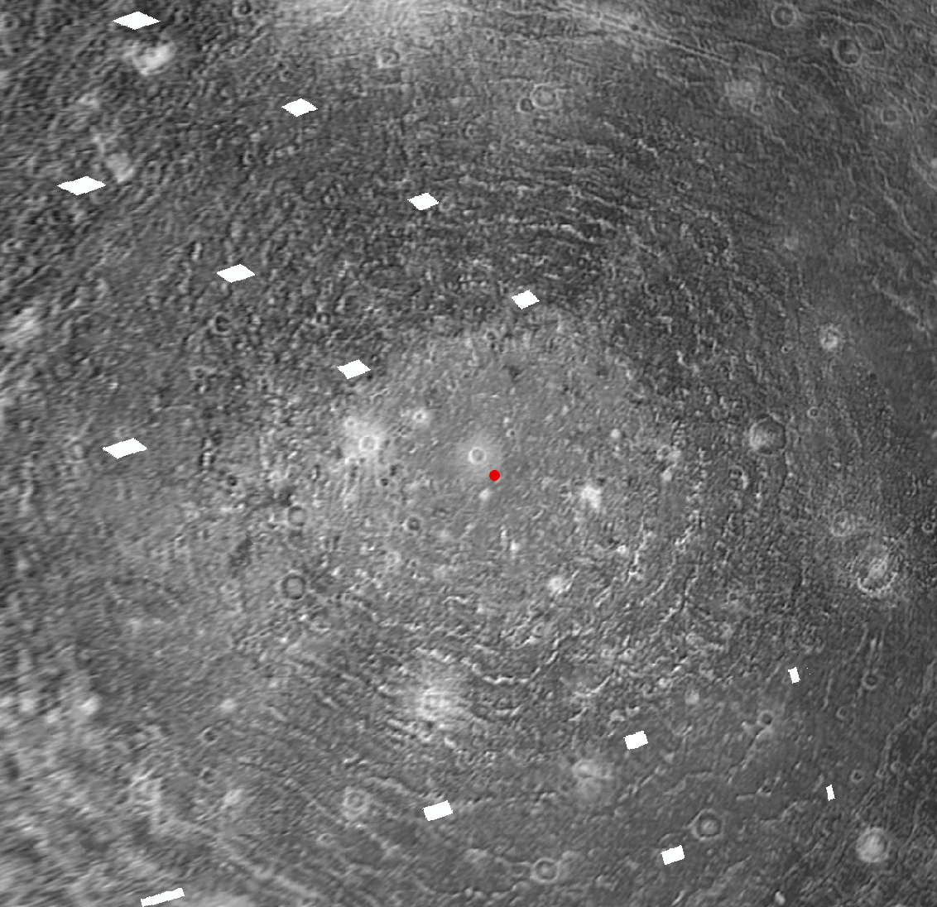
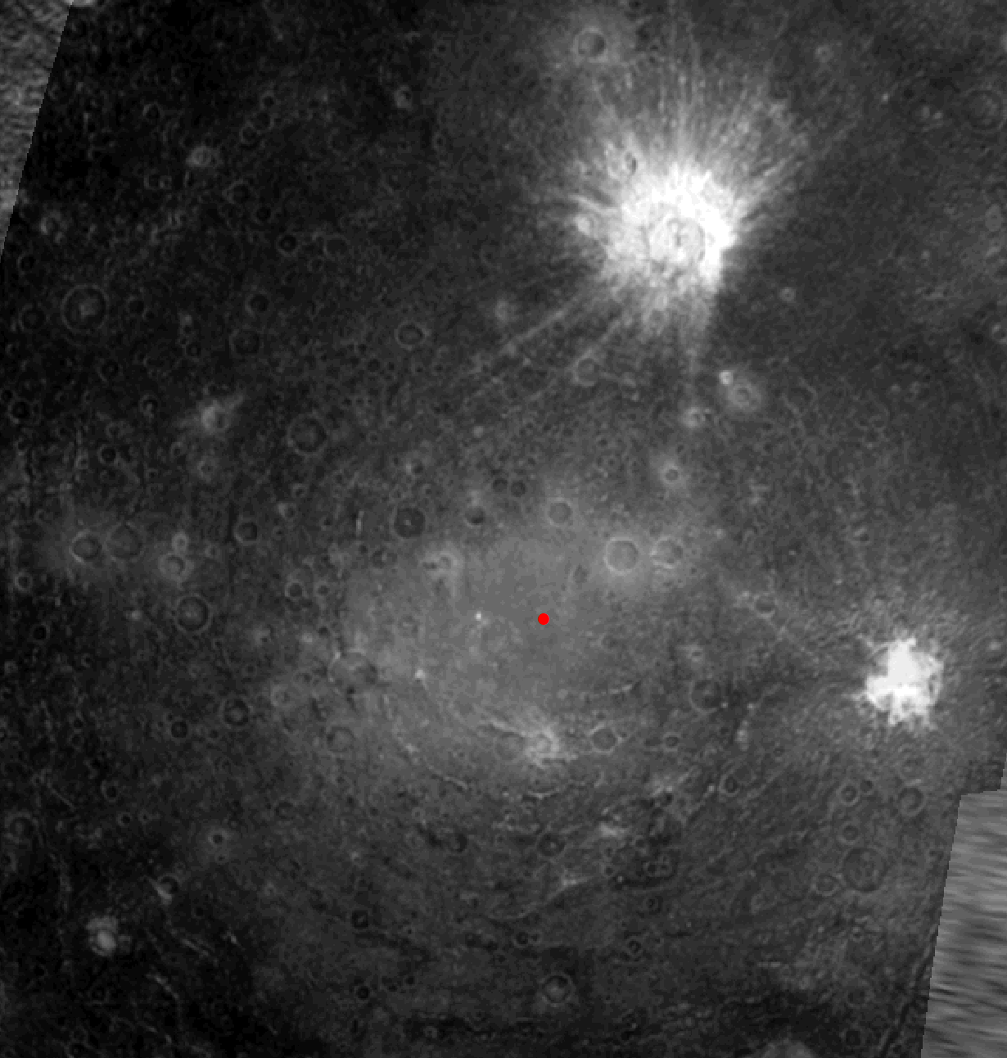
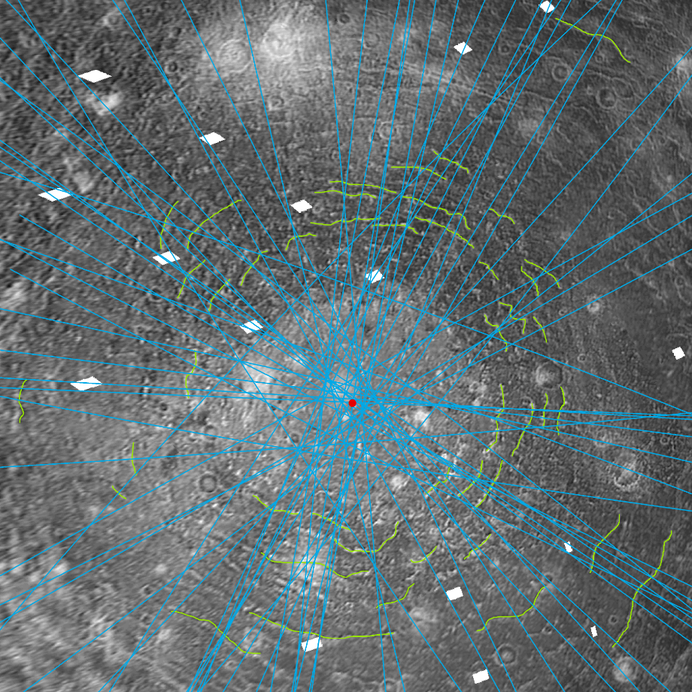
Valhalla | Asgard | Adlinda

Slide 6
Mapped Basin Example
Source: https://photojournal.jpl.nasa.gov/target/callisto

Slide 7
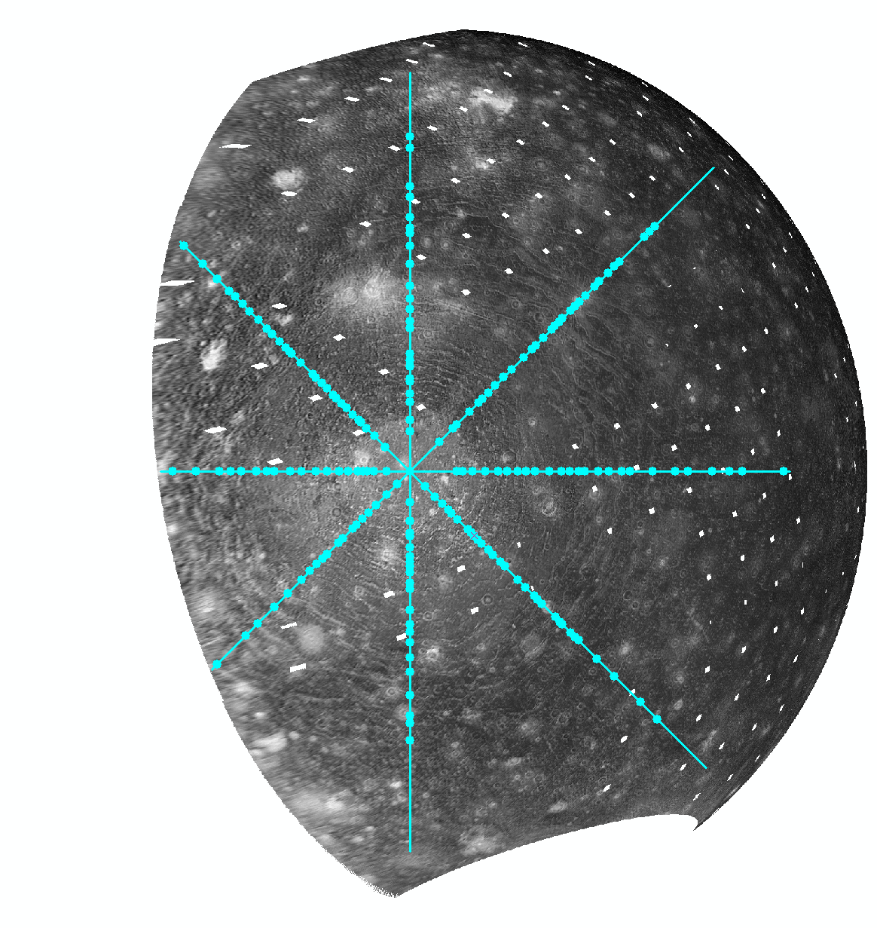
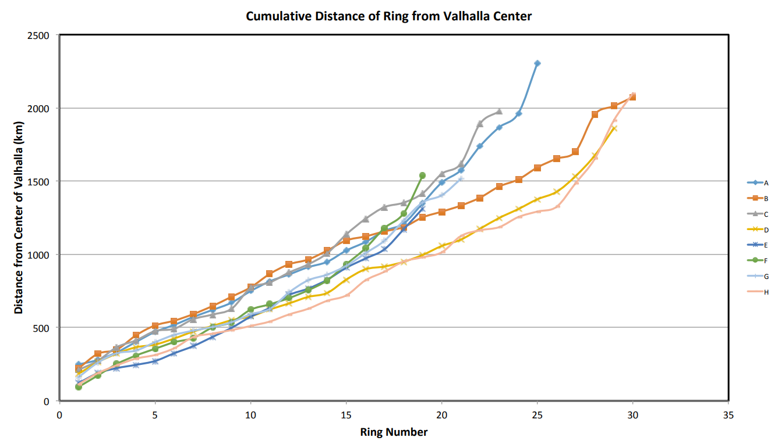
Mapped Basin Example
Notes:
Heat flow is how well the (planetary) body transfers energy through its subsurface. Low heat flow would yield a thicker crust as material would be in motion for less time whilst high heat flow would yield a thinner crust, due to an opposite situation where they cannot settle down. By estimating heat flow of such an inactive body, we can determine a baseline for how more active icy bodies' heat flow should evolve over time.

Slide 8
Results and Future Work
Valhalla already shows unique ring spacing along each transect
Evaluating topology of each mapped ring
Computer modelling of each impact basin
Checking for matches between morphometry results and simulation results
Estimating Callisto’s historical heat flow and evolution between relative impact times
Notes:
Discuss importance of results
Distance between rings increases as you reach the furthest extents of the image
morphometry- studying the physical shape of something

Slide 9
Acknowledgements
Dr. Veronica Bray
Dr. Oliver White
Staff of LPL and PIRL
Everyone at LPSC 2022
Notes:
Discuss importance of results
Distance between rings increases as you reach the furthest extents of the image
morphometry- studying the physical shape of something

Slide 10
Thank You
Notes:
Discuss importance of results
Distance between rings increases as you reach the furthest extents of the image
morphometry- studying the physical shape of something

